Slide 1

I/DD April
Lunch(ish) and Learn
April 30, 2026

Slide 2


Kim Barboza, Product Owner and Technology Manager
How long have you been with HHA? 8 years
Favorite part of the software? Configuring requirements
What do you do in your free time? Volunteer with Toledo TOPSoccer, a program that adapts the game of soccer for those with diverse abilities.
Olivia Karem, Implementation Specialist
How long have you been with HHA? 7 years
Favorite part of the software? Configuring security
What do you do in your free time? Take care of my fur babies Tilly and Otto and Knitting.

Slide 3
Requirements Overview
Requirement Fulfillment Type Categories
Requirement Due Date Options
Requirement Task Set Up and Visibility
Requirement Events
Requirement Plans and “Setup Mode”

Slide 4
Requirements
Overview
Overview

Slide 5
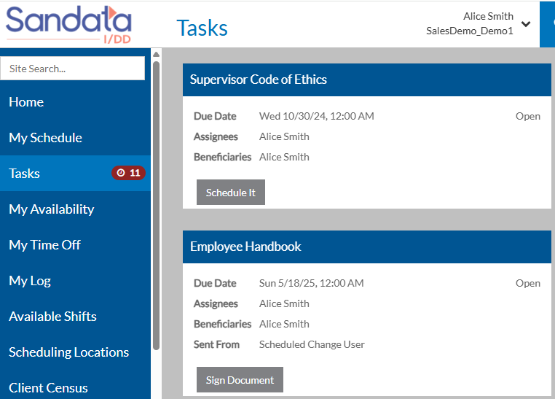


What are Requirements
Requirements automate recurring or one-time tasks with built-in workflows, reminders, approvals, and tracking. Once configured, they run automatically to help ensure important items are completed on time. Using Position and Placement Trees, along with Employee Groups, Requirements stay up to date with employee changes and client movement.
Requirements can be tied to positions, clients, or locations depending on the use case and:
Automates recurring tasks
Reduces manual reminders, spreadsheets, and follow-ups
Improves visibility with built-in approvals and progress tracking
Scales easily across employees, clients, and locations

Slide 6
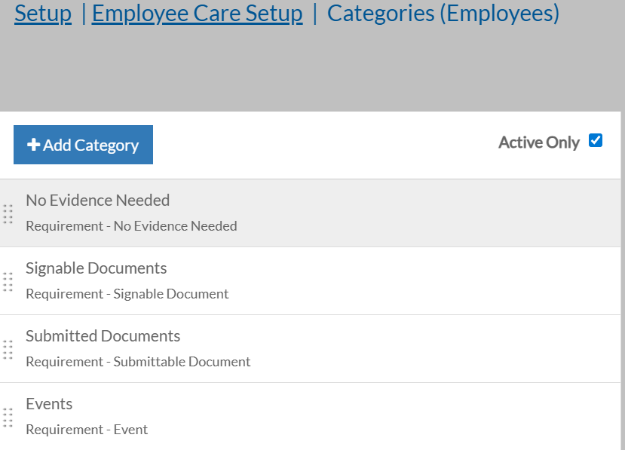
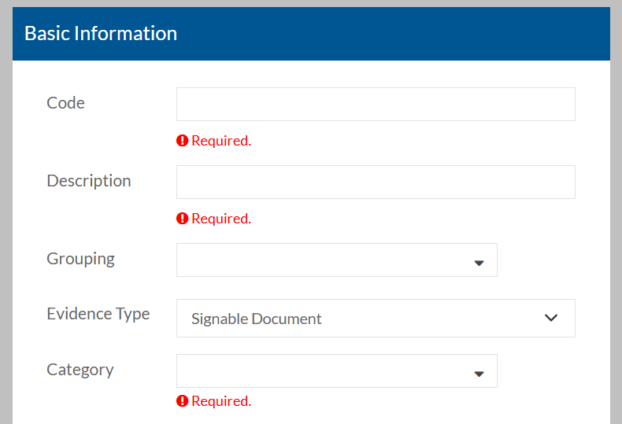
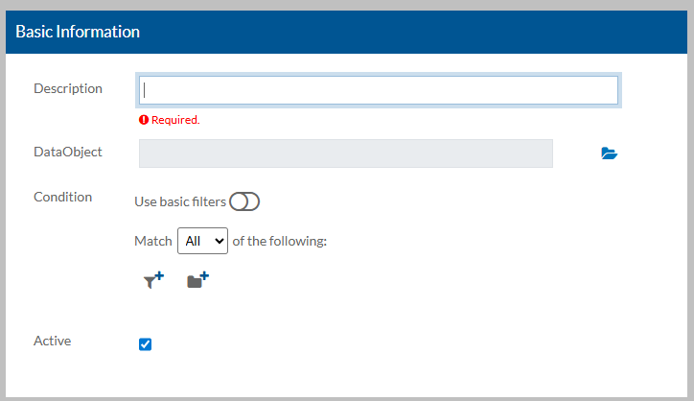
Requirement Setup Overview
Requirements are available in Employee Care and Client Care. To access in Employee Care go to Employee Care > Setup > Applications* or Employee Requirements Card. To access in Client Care go to Client Care > Setup > Client, Placement, Client Placement or Program Plan Requirements Card.
Categories - How employees will complete requirements
Manage Requirements –Creation and setting up tasks
Requirement Plans – Filtered listing to assign requirements
  *Part of Applicant Tracking System (ATS) to be re-released later this year

Slide 7
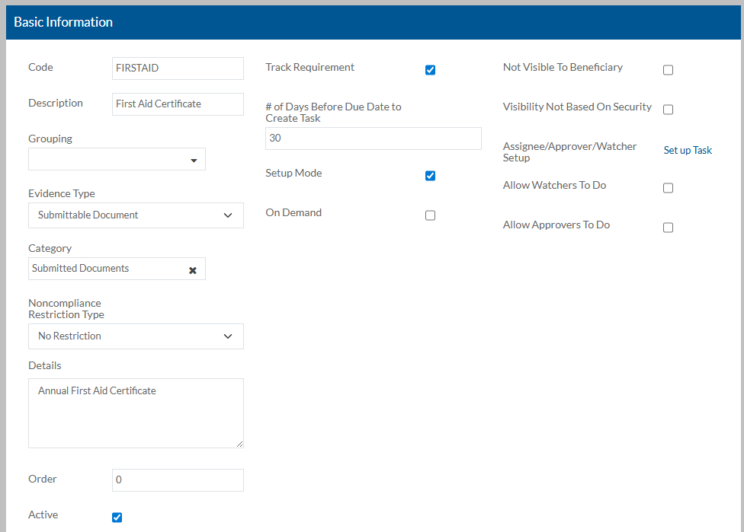
Requirements Setup Basic Information
The Evidence Type should match the Category being used to fulfill the requirement.*
Setup Mode will prevent tasks from being created until you are ready while also allowing you to review records to confirm expected results.
You can hide the Requirement from the Beneficiary for items like New Hire background checks completed by HR.
You can restrict access to only those that are part of the Requirement Task.
You can set up Tasks for each Requirement or use a “preset” and choose to allow Watchers and/or Approvers to complete on behalf of the Assignee.*
3
4
2
5
1
  *Will review in detail on later slides

Slide 8
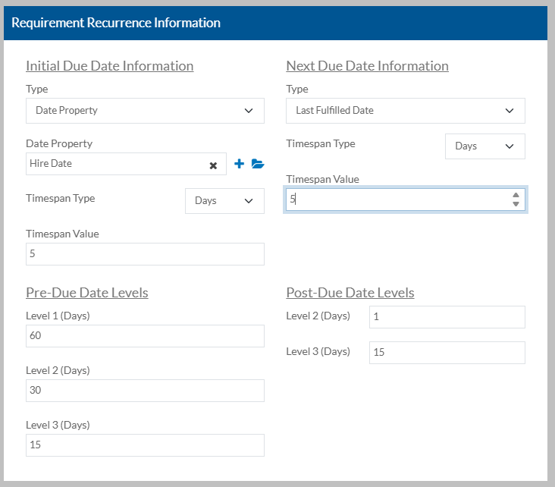
Requirements Setup Requirement Recurrence
The Initial Due Date is the first time an Employee will see this Requirement and will typically filter to a Client or Employee profile date field or the Effective Date of being filtered to a Requirement Plan.*
You can calculate a timespan PAST the Initial Due Date that the Requirement is due.
The recurrence of a Requirement can be set up as calculated on the last time it was fulfilled, calendar days or Employee entered due date at the time of completion.*
You can calculate a timespan PAST the Next Due Date that the Requirement is due.
These dates are for reporting purposes.
1
3
4
2
5
  *Will review in detail on later slides

Slide 9
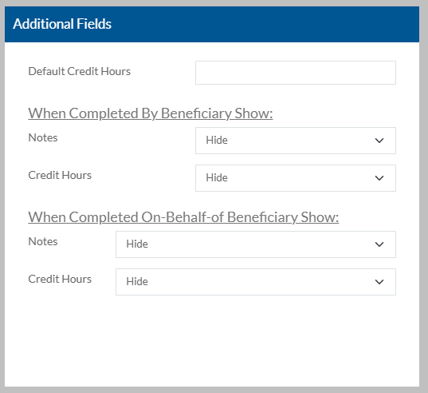
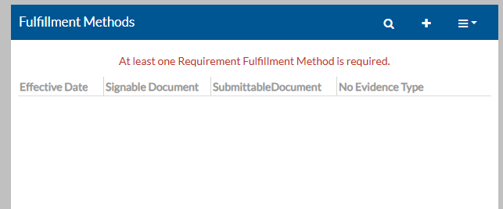
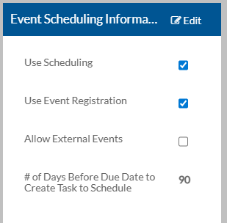
Requirements Setup Add’l Fields and Fulfillment
You can note the Default Credit Hours expected.
You can choose to have any Notes or Credit Hours information visible to those completing the task.
You will choose a Fulfillment Method that matches the Category chosen on the Basic Information Card.*
Will only be visible for an Event type Requirement where you can mark Use Scheduling to create a task that will require satisfactory completion to fulfill the Requirement.
Allow staff to choose from a list of Event offerings tied to the Requirement or record an External Event.*
You can decide how many days before the Requirement Due Date that Staff can sign up for an Event.
1
2
3
4
5
  *Will review in detail on later slides
6

Slide 10
Requirement
Fulfillment Type Categories
Fulfillment Types

Slide 11
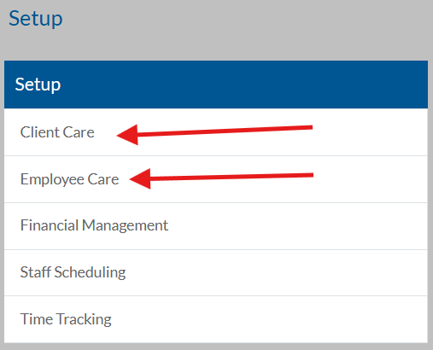
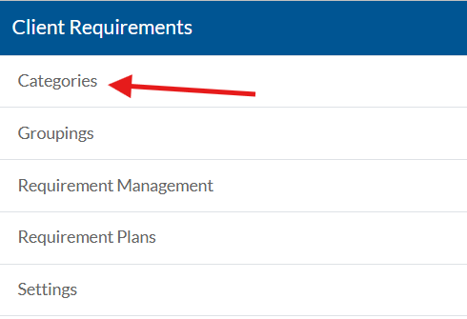
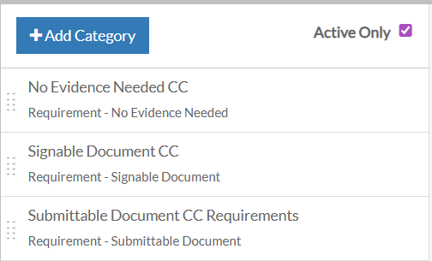
Categories Setup
Categories are used to organize and store the evidence that will determine if a Requirement has been fulfilled.
Categories can be found under Employee Care or Client Care Setup.
Locate the corresponding Requirements card and select Categories from here.
Select Add Category or select an existing category to view and manage the items within it.
Best practice naming convention is to name Categories for their Plan Item Types: No Evidence Need, Signable Documents, Submittable Documents, Events*, and Self-Service/Custom Form. (Only 1 Category per Plan Item Type is needed)
  *Requires additional licensing and will be re-released later.

Slide 12
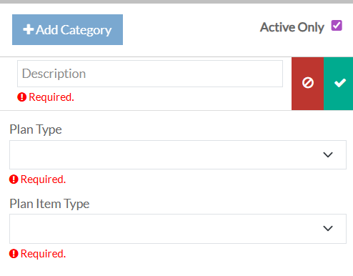
Adding a New Category
To add a category, select Add Category, complete the following information, and select the green check mark to save the new category (or red to cancel).
Description: A user- friendly description of the category
    NOTE: Best practice naming convention is to name Categories for their Plan Item Types.
Plan Type: Requirement
Plan Item Type: No Evidence Need, Signable Documents, Submittable Documents, Events, Quiz* and Self-Service/Custom Form
    NOTE: The list of Plan Item Types available varies based on licensing and the type of requirement.
1
2
3
  *Requires additional licensing and will be re-released later.

Slide 13
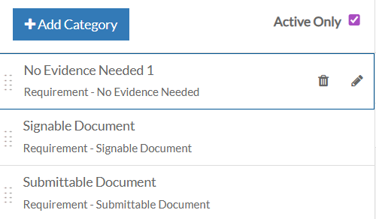
Category Plan Item Types
Only one category is needed for each type.
No Evidence Needed: A person simply marks these as complete.
Signable Documents: A document, such as an agreement or application that the person signs. (These require signature profiles.)
Submittable Documents: A document a person uploads, such as a photograph of a driver's license, a certificate of completion, etc.
Events: A class held in-person or online (employee-based requirements only)
Self Service Form: most common use is to complete Program Plan Assessments (Client Care Program Plan Requirements)

Slide 14
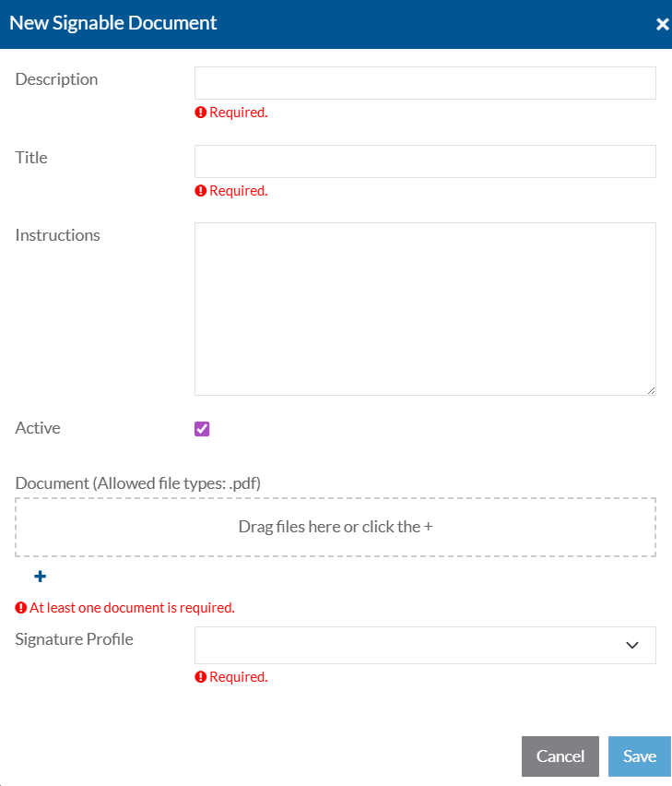
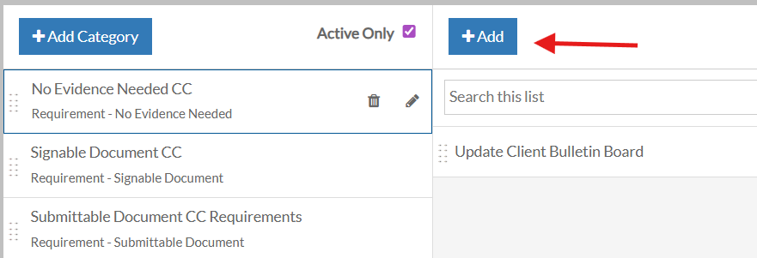
Adding an Evidence Type to a Category
Once a category is created, you can add the associated Evidence Type to the category. A category can have multiple evidence types associated to them.
Note: this is not required for Events as these will link to an event.
To do this, click on the Category, then click Add.
The form to populate will appear different based on Category Plan Item Type.

Slide 15
A Closer Look Inside the Platform
Requirement Overview
Categories for Requirement Fulfillment Options
Signature Profiles
(We’ll review Events in detail later)
Now, we’ll jump into the system and highlight the key visuals — including the actual pages and fields.

Slide 16
Requirement
Due Date Options
Dates

Slide 17
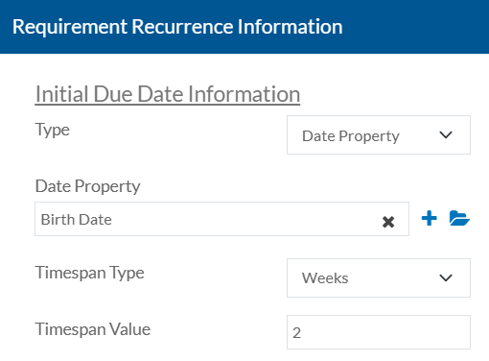
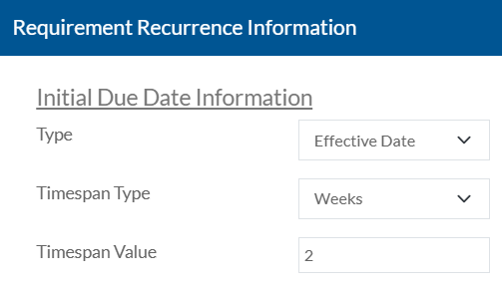
Initial Due Date Information
Immediate - The requirement is due to be completed as soon as a filter in a requirement plan is true for the employee, application, client, client placement, placement or program plan.
Date Property - The requirement is due to be completed X days, weeks, months or years (based on Initial Due Date Timespan Type and Value) after the date set in the date property selected in the Initial Due Date Property. NOTE: the property must be populated or the status will be "error".
Effective Date - The requirement is due to be completed X days, weeks, months or years (based on Initial Due Date Timespan Type and Value) after the date a filter in a requirement plan is true for the employee, application, client, client placement, placement or program plan.
2
3

Slide 18
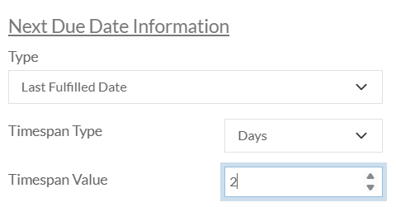
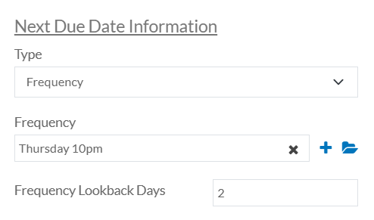
Next Due Date Information
Last Fulfilled Date - The next due date will be calculated based on the date it was fulfilled last and the next due date timespan type and value.
Manual Expiration Date - The user will enter the next due date when they complete the requirement.
Frequency - The next due date will be based on the frequency selected.
One Time - The requirement only had to be completed once and is not recurring.
1
3

Slide 19
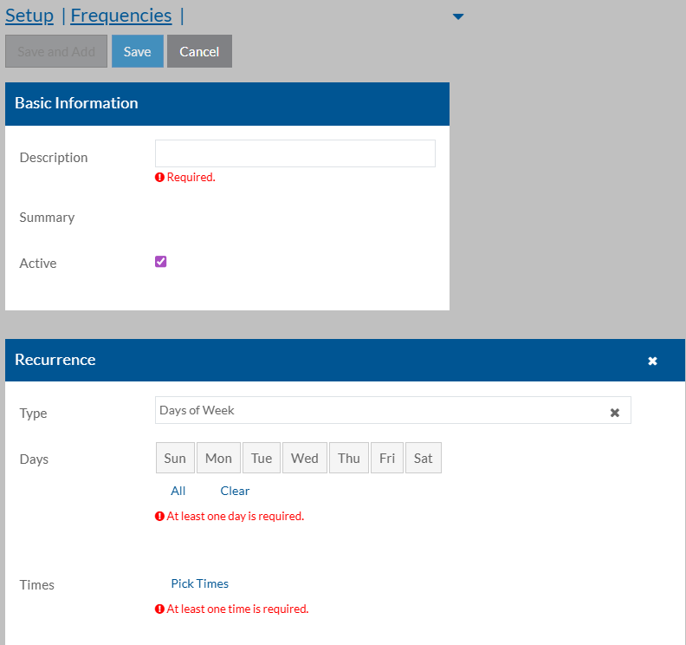
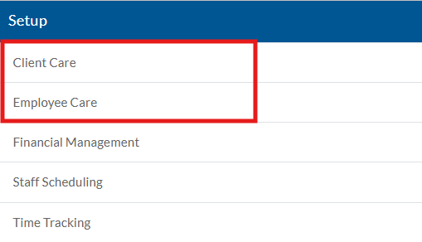
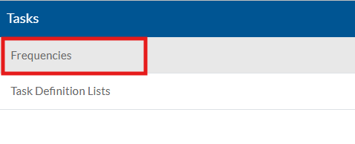
Frequencies
If Frequency is selected as the Next Due Date, a list of frequencies set up in the system will appear. These set up items can be found under Employee Care or Client Care Setup. They are found in the Tasks section.
To set up a new frequency, click the +. A description is required and then a recurrence must be set up.

Slide 20
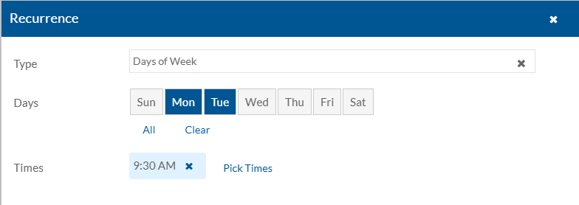
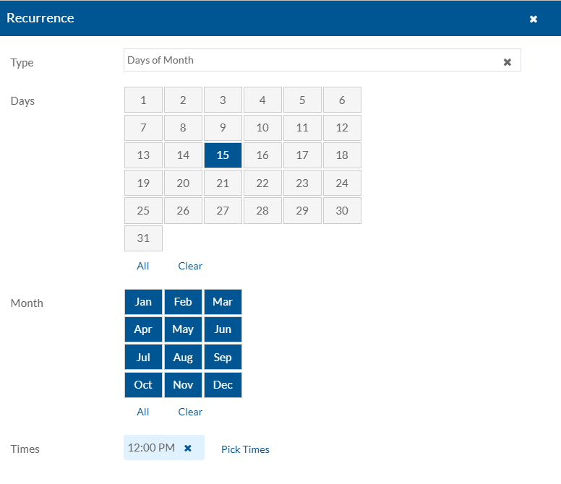
Frequency Recurrence Setup
There are multiple recurrence Types to choose from.
1. Days of the Week: on the selected day(s) of the week at the selected time(s) the requirement will be due.
2. Days of Month: on the selected day(s) of the month on the month(s) selected and at the time(s) selected the requirement will be due.

Slide 21
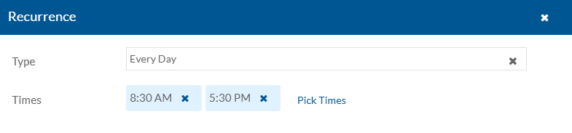
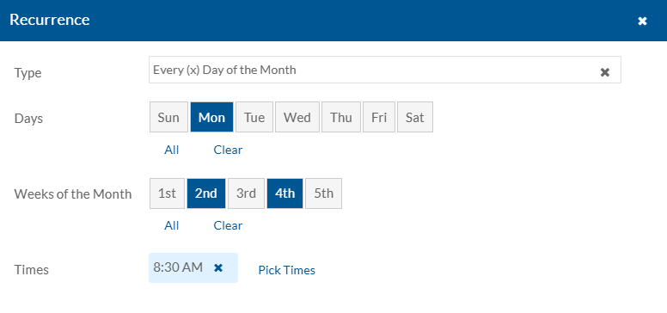
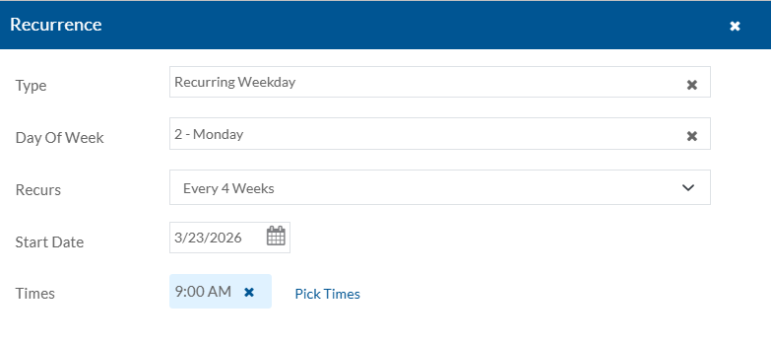
Frequency Recurrence Setup
3. Every Day: the requirement would be due every day at the time(s) selected.
4. Every (x) Day of the Month: on the selected day(s) of the selected week(s) of the month at the selected time(s) the requirement would be due.
5. Recurring Weekday: on the selected day of the week the requirement would recur based on the recurrence set up (1 week, 2 week, etc.). This would begin at the start date entered at the time(s) set up.

Slide 22
Requirement
Task Setup and Visibility
Tasks

Slide 23
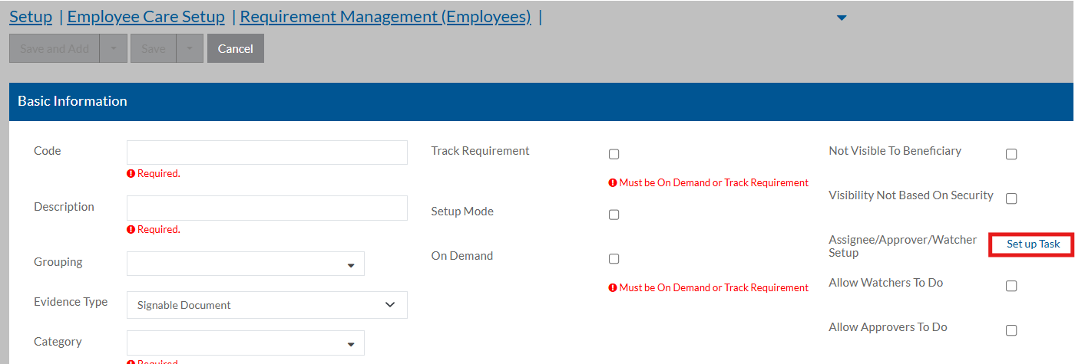
Requirement Tasks Setup
The Task is where you will set up assignees to complete the requirements, as well a as Approvers and Watchers of the requirement. It is found on the requirement in Requirement Management.
Assignee/Approver/Watcher Setup: where assignees, approvers (if applicable) and watchers can be set up for the task. More info on next slide.
Allow Watchers To Do: if checked, anyone set up as a Watcher can complete the task.
Allow Approvers To Do: if checked, anyone set up as an Approver can complete the task.

Slide 24
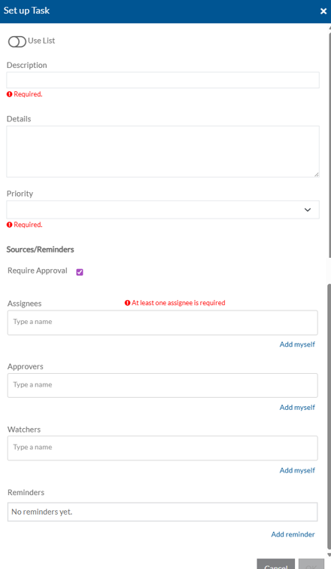
Assignee/Approver/Watcher Setup
Description: a short description of the task.
Priority: the priority of the requirement task.
Assignees: Select the beneficiary relationships, positions, employee groups, or users that will complete the requirement task.
Approvers: If Require Approval is on, select the beneficiary relationships, positions, employee groups, or users that will approve the completed requirement task.
Watchers: Select the beneficiary relationships, positions, employee groups, or users that need to track the requirement task.
NOTE: Approvers and Watchers can view the details of the beneficiary's completed requirements.

Slide 25
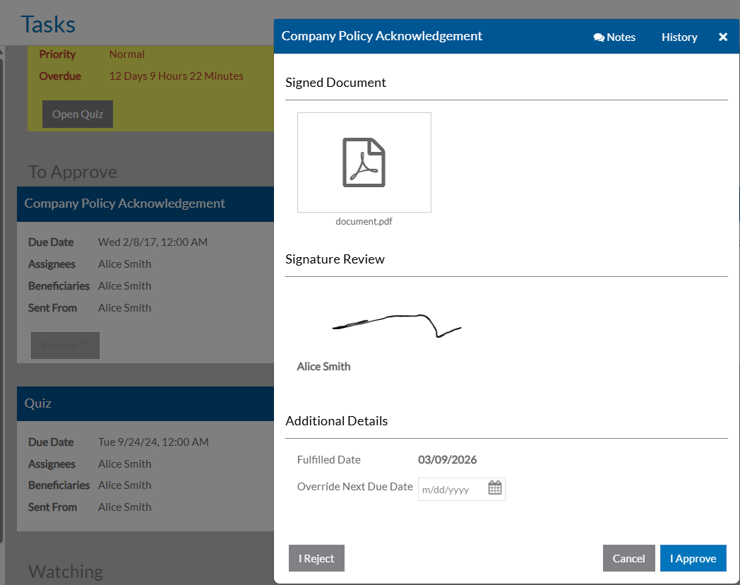
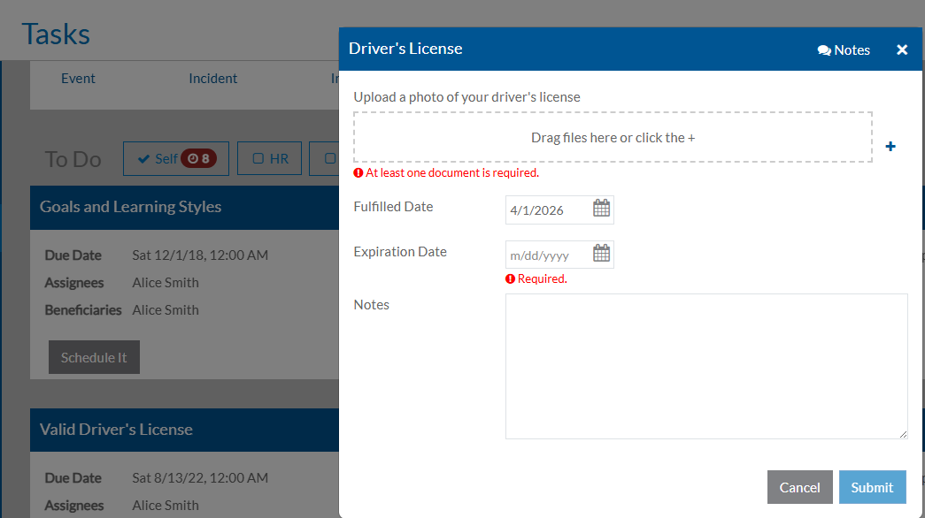
Task Completion and Approval
  One a task has been generated for a requirement, it will show on the Tasks screen alongside other tasks.
  Both submissions and approvals can be completed directly from the Task Card.

Slide 26
A Closer Look Inside the Platform
Requirement Due Dates
Requirement Task Setup
Completing a Task
Now, we’ll jump into the system and highlight the key visuals — including the actual pages and fields.

Slide 27
Requirement
Events
Events

Slide 28
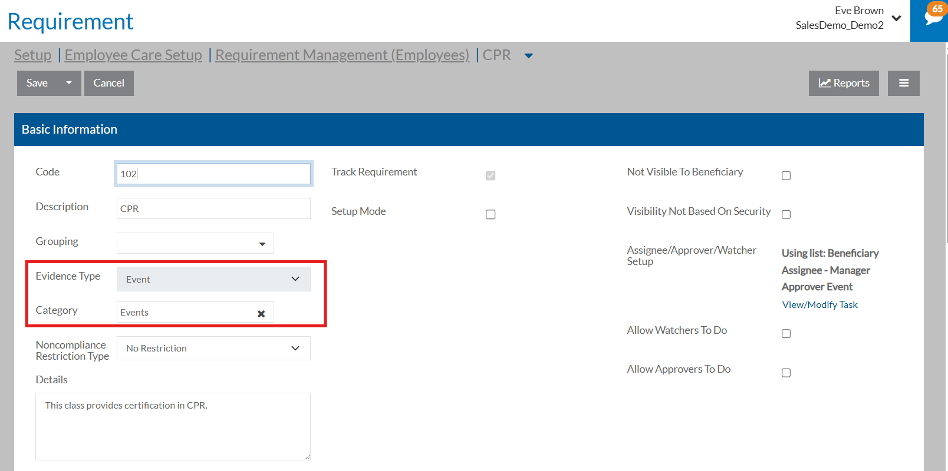
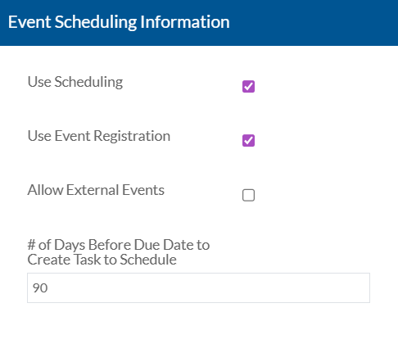
Requirement Events Setup
In Employee-based Requirements, a requirement can be set up as an Event in DataPlus. To do this, you would set up the event requirement in Requirement Management by marking the Evidence Type Event and then linking the Category that was set up for the Plan Item Type Events.
You would then go to the Event Scheduling Information.
Use Scheduling: Select to allow a scheduling task to be created for the event. The requirement will not be marked fulfilled until the employee completes the event with a passing score.
Use Event Registration: Select to allow employees to register for any events tied to this requirement.
Allow External Events: If selected when scheduling an event that fulfills this requirement, the employee can select Use External Event and enter the information about the event they are attending.
# of Days Before Due Date to Create Task to Schedule: The number of days before the requirement due date that staff will see a task card to register for an event to fulfill this requirement.

Slide 29
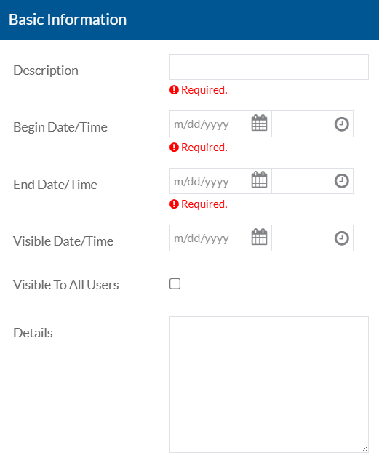
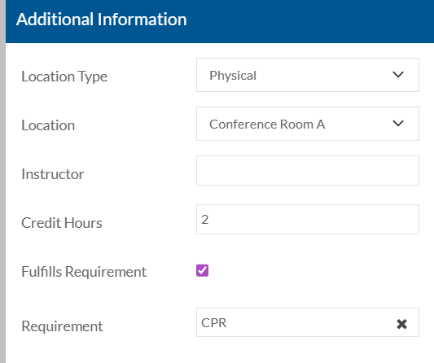
Event Management Setup
Once the Requirement is set up in Requirement Management, you can then create an Event in Event Management. This is found in Employee Care > Event Management.
Click + to add a new Event. On the Basic Information Card, fill out all required fields.
Description
Begin Date/Time and End Date/Time
Visible Date/Time: This is when the event will start appearing for employees to view.
Visible to All Users: The event will appear under Events on the Resources card for all users to view
Details
Additional Information Card:
  Location Type: Physical or Online
    Location (if Location Type is Physical)
    Online Meeting URL (if Location Type is Online)
  Instructor
  Credit Hours: if Fulfills Requirement is selected, this will automatically populate based on the requirement.
  Fulfills Requirement: select this to map to a requirement.
  Requirement: If Fulfills Requirement is selected, select the requirement it fulfills. Only requirements with a Type of Event will appear. This field cannot be changed after the event is saved.

Slide 30
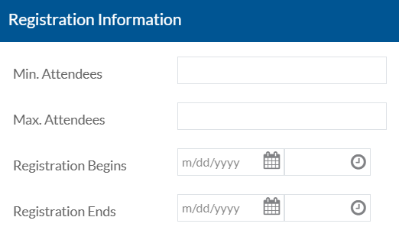
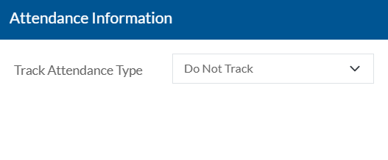
Requirement Events Setup
Registration Information Card:
Min. Attendees: Leave this 0 if there is not a minimum event size.
Max. Attendees: Leave this 0 if there is not a maximum event size. Once the maximum is met, no one else will be able to register for it.
Registration Begins: The date and time users can start registering for the event. It must be on or after the visible date.
Registration Ends: The date and time users are no longer able to register for the event.
Attendance Information Card:
Track Attendance Type: Do Not Track, Attendance Only, Graded - Pass/Fail, Graded - Percent. Once you save the event, you cannot change this field.
Passing Percent: If Tracking Attendance Type is Graded - Percent, enter the passing percentage.
Click Save. The Events Action and User Roles section will then appear. The Event Action section will be blank unless a User Role has been set up for the user on that event.

Slide 31
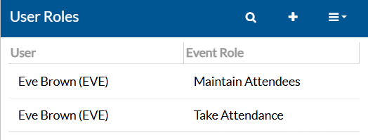
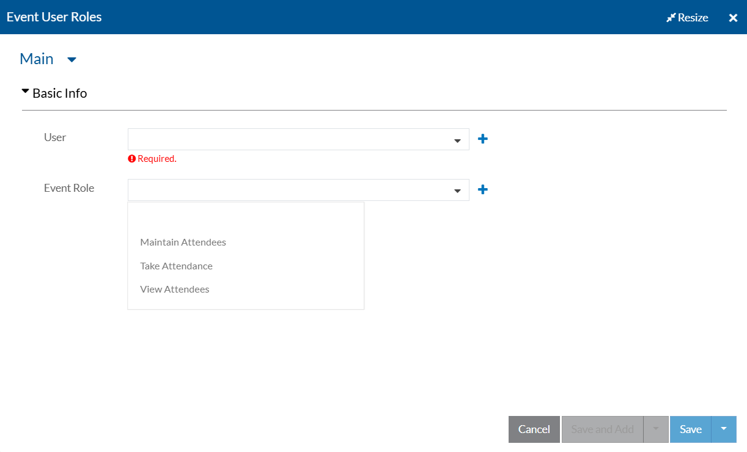
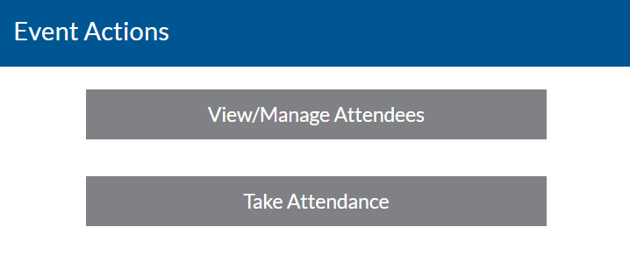
Events User Roles
User Roles:
User: enter the employee that will need an Event Role.
Event Role:
  View Attendees: can view who is registered for an event.
  Maintain Attendees: can add or remove registered attendees from an event.
  Take Attendance: can mark attendance of an event.
Click Save. The user will now see a button in their Event Actions section stating View/Manage Attendees and/or Take Attendance, based on their User Role setup.

Slide 32
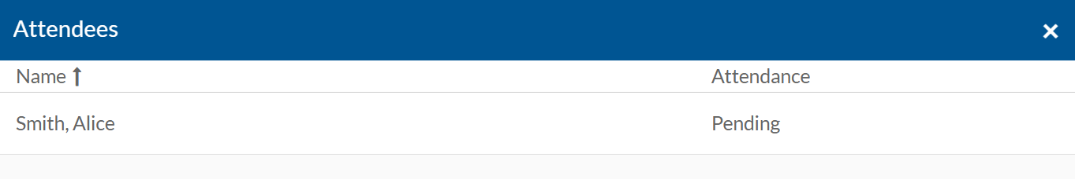
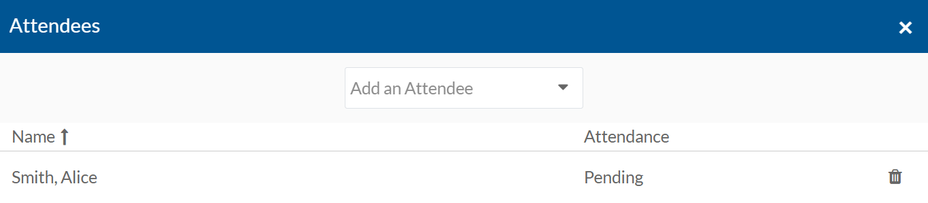
View/Manage Attendees
If a user is set up in an Event with View Attendees or Maintain Attendees access, they will now see a button in their Events Action section to View/Manage Attendees.
If user has View Attendees access and click on the button, they will only be able to view the registered employees and their current attendance status.
If user has Maintain Attendance access, they are able to add and remove attendees from the Event.

Slide 33
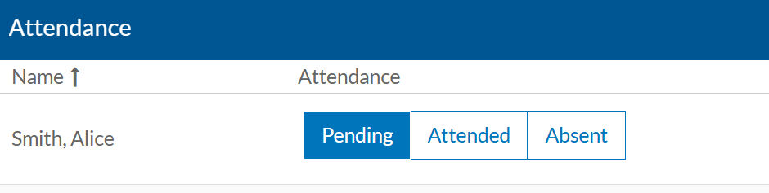
Take Attendance
If a user is set up in an Event with Take Attendance access, they will see the Take Attendance button as well as the View/Manage Attendees button in their Event Actions section. This is because Take Attendance users also are given view access to the event.
To take attendance, click the Take Attendance button. A list of registered users will appear, with the ability to update the user’s Attendance status from Pending to Attended or Absent.
If attendance is updated to Attended, the requirement will automatically be marked as Complete in the system. If Absent is selected, the task will re-appear for the assignee to register again.

Slide 34
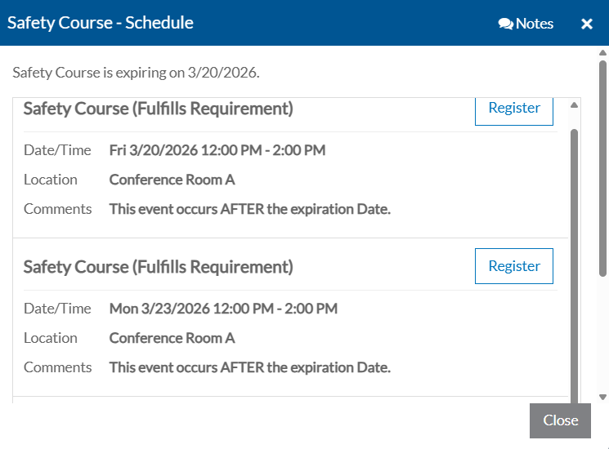
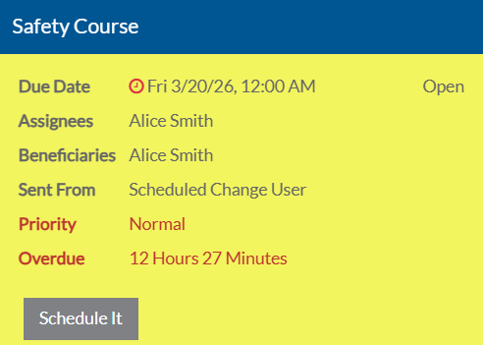
Employee Registration for Event Requirement
Once the requirement event is set up in Requirement Management and the event is set up in Event Management, the task assignee should be able to register for the event. To do this, they can go to the task and click Schedule It. This will then bring up a list of the Events set up in Event Management for the requirement. They can select which event they would like to attend by clicking Register. A pop-up will appear to Confirm registration. Click Confirm.
Once the attendance status for the employee on the event has been updated to Attended, the Requirement will be marked as Complete.

Slide 35
Requirement
Plans and "Setup Mode"
Setup Mode and Plans

Slide 36
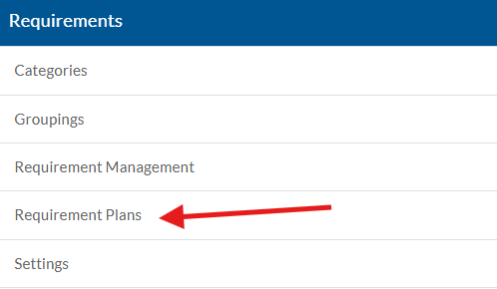
Managing Requirement Plans
Requirement Plans determine which requirements are applicable to certain employees, applications, clients, client placements, placements, or program plans.
They can be found under Employee Care or Client Care Setup.
Locate the corresponding Requirements card and select Requirement Plans.
Select the + or select a requirement plan card to open it.

Slide 37
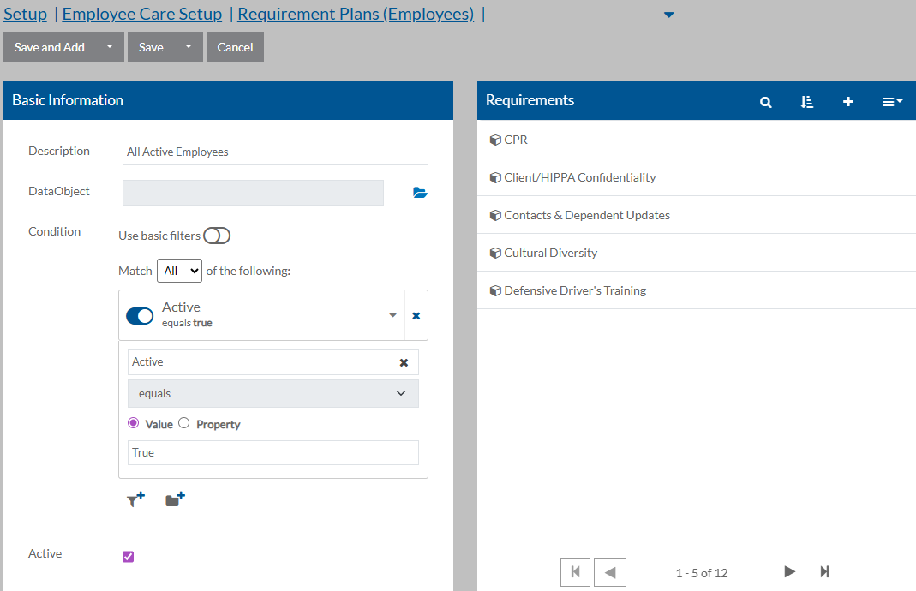
Adding a Requirement Plan
Complete the Basic Information card by adding a Description and a Condition.
    For the Condition, set a filter to determine which employees, applications, clients, client placements, placements, or program plans that the selected requirements apply to.
On the Requirements card, click the + to attach the requirement(s) that are applicable to this subset of employees, applications, clients, client placements, placements, or program plans based on the filter settings in the Condition.

Slide 38
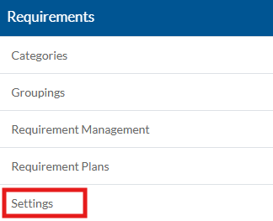
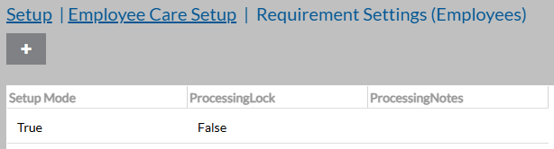

Setup Mode
Setup Mode is a required setting that allows you to configure multiple requirements and requirement plans without generating Tasks or Requirement Status transactions. During setup, ensure Setup Mode is set to TRUE. This allows you to build and adjust requirements safely before they are active. When you are ready to go live, you can turn Setup Mode off.
Important: Once Setup Mode is turned off, do not turn it back on. After initial “go live”, setup mode is controlled at the requirement level.
How to use:
Go to Employee Care Setup or Client Care Setup
Go to (Any) Requirements card and choose Settings
Click “+” and set Setup Mode = TRUE
When ready, uncheck Setup Mode and save
Ensure it is also unchecked on individual requirements

Slide 39
A Closer Look Inside the Platform
Requirement Events
Requirement Plans
Setup Mode
Now, we’ll jump into the system and highlight the key visuals — including the actual pages and fields.

Slide 40

What’s Next?
Focused support for the next 60 days to help with adoption
Explore and experiment with the new features in your databases
Submit requests for assistance, we are here to support you
Coming in June
Our next Lunch(ish) and Learn will cover the Employee Care Applicant Tracking System (ATS) with an application Applicants can fill out themselves, Client Care Service Plans designed to be Person Centered and brings together all documentation and contracts, and we will review updates from the last quarter.

Slide 41
Questions?
When are requirements and tasks generated?
  Learning Center link
Requirements Overview
Requirement Fulfillment Type Categories
Requirement Due Date Options
Requirement Task Set Up and Visibility
Requirement Events
Requirement Plans and “Setup Mode”

Slide 42
Thank you!

